Slide 1
Newton enclosure: defended settlement during later prehistory
Thomas Rees Rathmell Archaeology Ltd

Slide 2
This session
Introduction
Rediscovery by RCAHMS in 1977
The Nature of Forts and Ring-Forts
Survey and Geophysics
Community excavation
Newton Enclosure in context
Summary

Slide 3
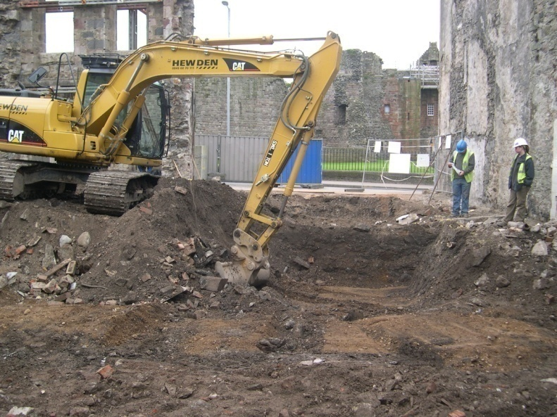
Hosea 8:7
Commercial Company
Founded in 2003
Based in Ayrshire
Work in Northern Britain

Slide 4
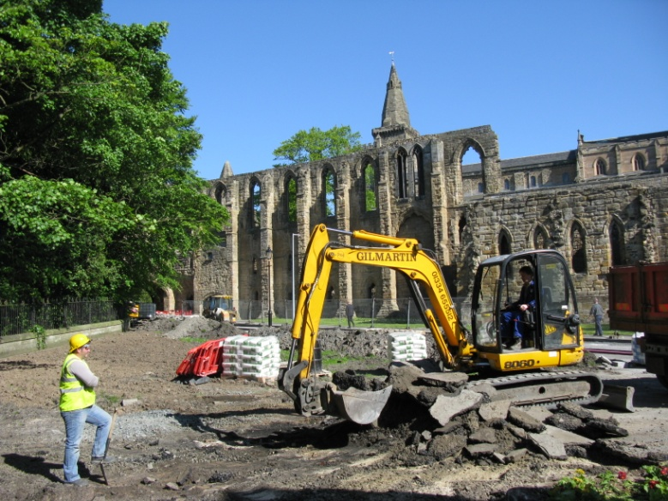
Hosea 8:7
Commercial Company
Founded in 2003
Based in Ayrshire
Work in Northern Britain

Slide 5
Hosea 8:7
Commercial Company
Founded in 2003
Based in Ayrshire
Work in Northern Britain

Slide 6
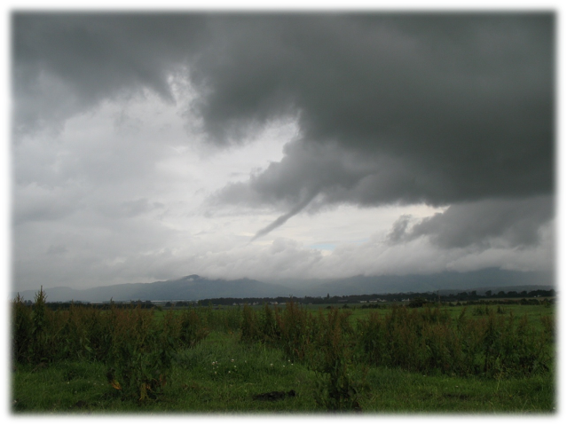
Introduction

Slide 7
Introduction

Slide 8
Introduction

Slide 9
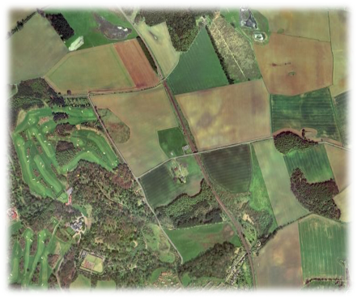
Introduction

Slide 10
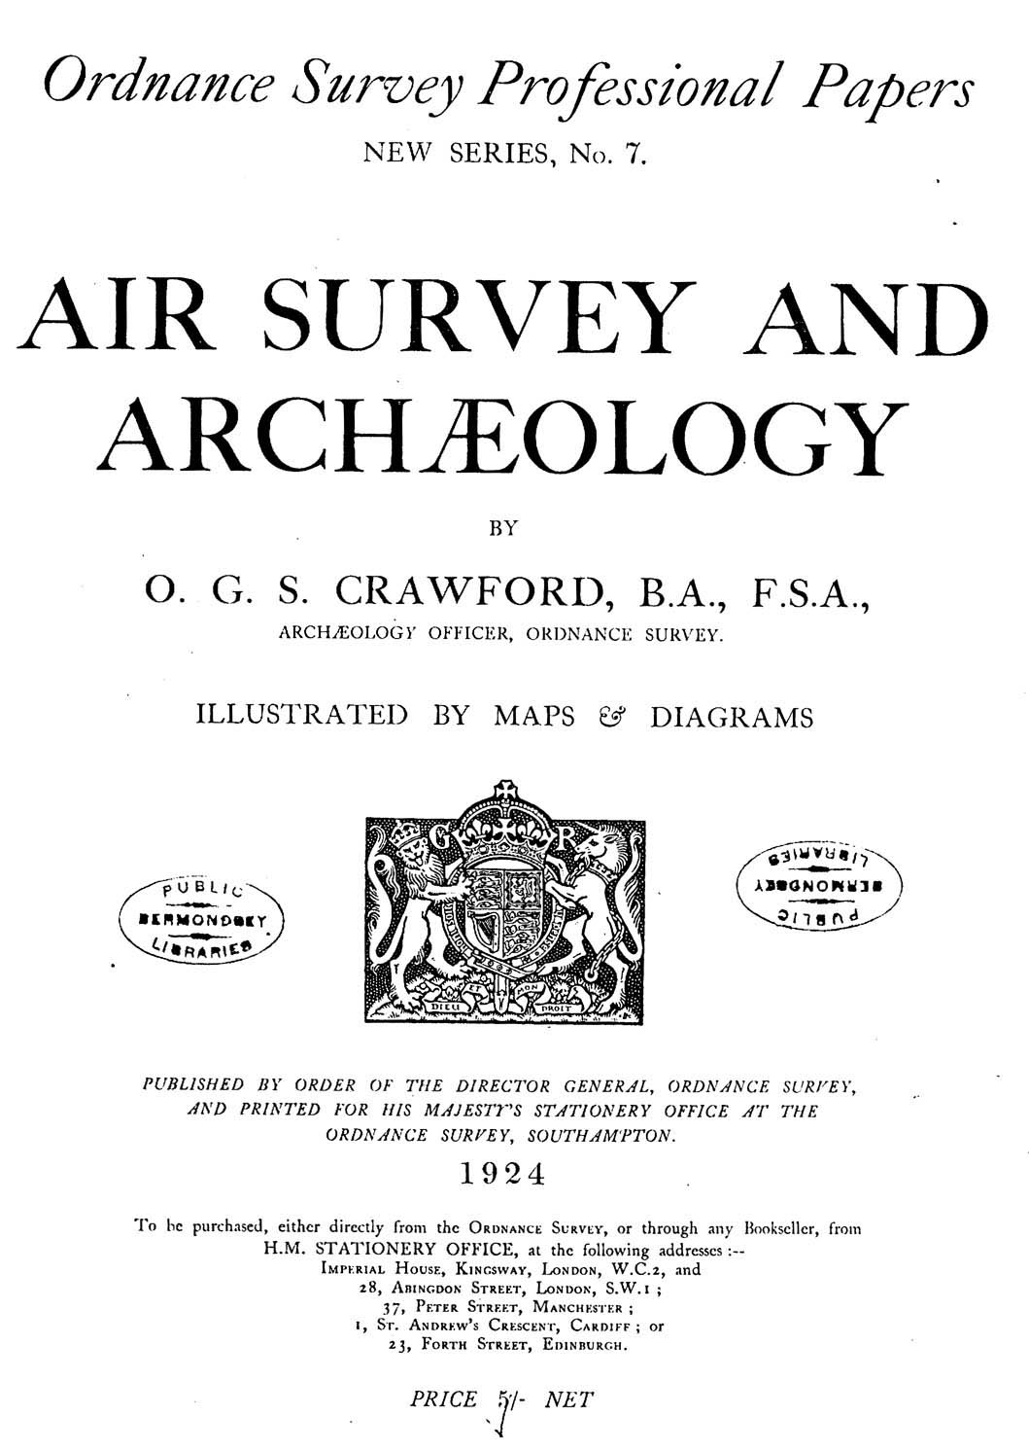
Rediscovery by RCAHMS in 1977

Slide 11
Rediscovery by RCAHMS in 1977

Slide 12
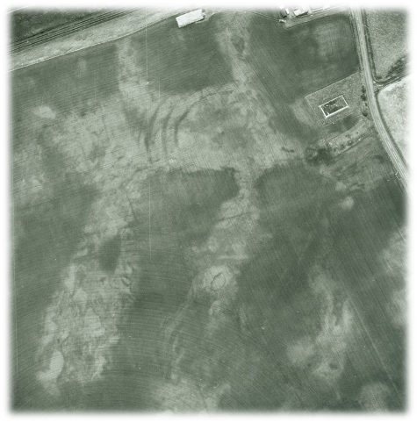
Rediscovery by RCAHMS in 1977

Slide 13
Rediscovery by RCAHMS in 1977

Slide 14
Rediscovery by RCAHMS in 1977
Positive Cropmarks
Double concentric circle features – Probable ring ditch burial

Slide 15
Rediscovery by RCAHMS in 1977
Positive Cropmarks
Double concentric circle features – Probable ring ditch burial
Arcing features – Enclosure ditches

Slide 16
Rediscovery by RCAHMS in 1977
Positive Cropmarks
Double concentric circle features – Probable ring ditch burial
Arcing features – Enclosure ditches
Circular features – Pits

Slide 17
Rediscovery by RCAHMS in 1977
Positive Cropmarks
Double concentric circle features – Probable ring ditch burial
Arcing features – Enclosure ditches
Circular features – Pits
Amorphous features – Geological variation

Slide 18
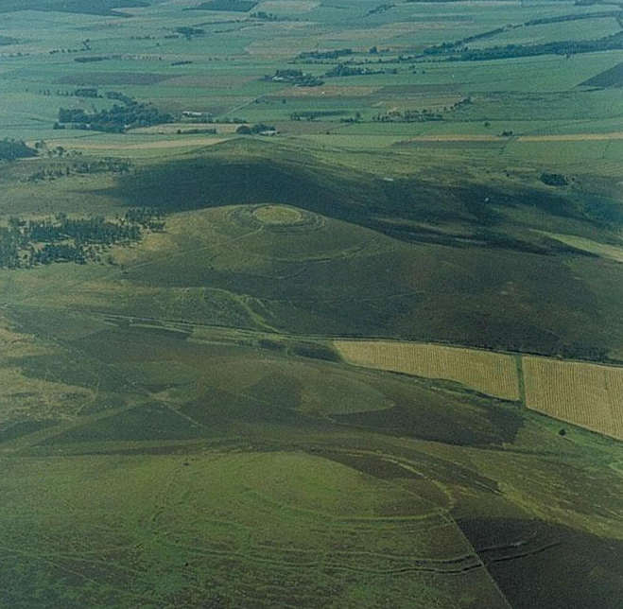
The Nature of Forts and Ring-Forts
A. Brown & White Caterthun

Slide 19
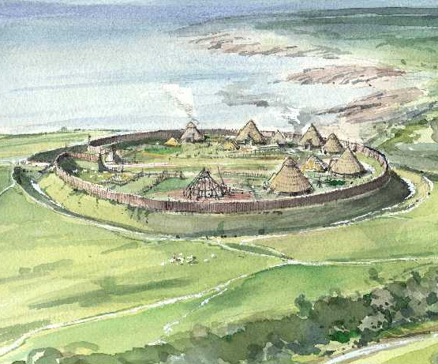
The Nature of Forts and Ring-Forts
A. Brown & White Caterthun
B. Reconstruction of Iron Age defended site

Slide 20
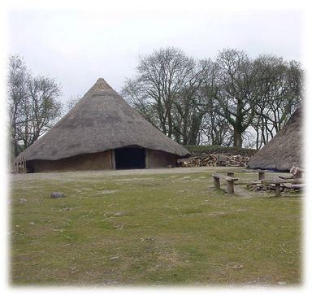
The Nature of Forts and Ring-Forts
A. Round houses
B. Reconstruction of Iron Age defended site

Slide 21
The Nature of Forts and Ring-Forts
A. Mains of Edzell aerial photograph

Slide 22
The Nature of Forts and Ring-Forts
A. Mains of Edzell aerial photograph
B. Mains of Edzell excavation plan

Slide 23
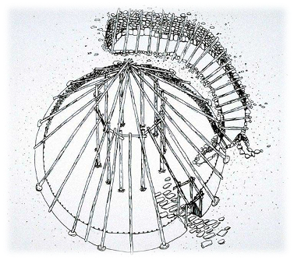
The Nature of Forts and Ring-Forts
A. Round house reconstruction
B. Mains of Edzell excavation plan

Slide 24
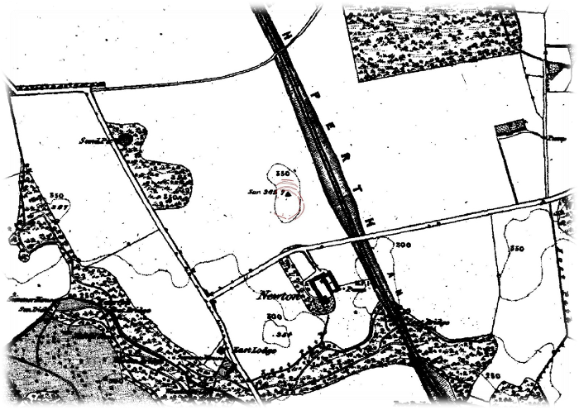
Survey and Geophysics
1852-55

Slide 25
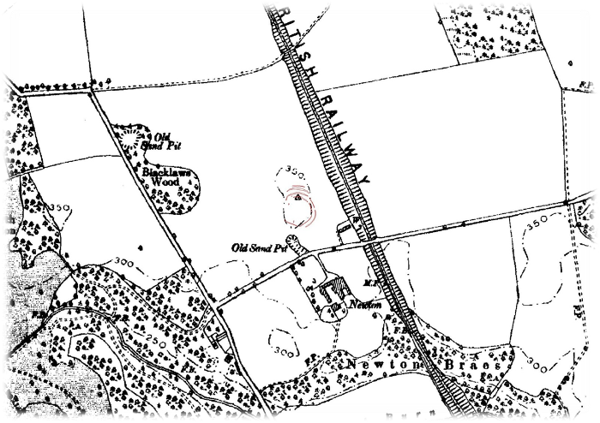
Survey and Geophysics
1893-95

Slide 26
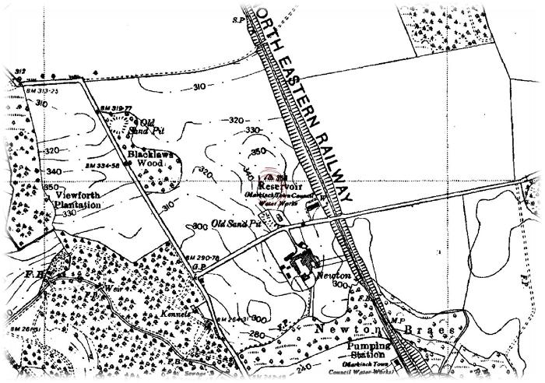
Survey and Geophysics
1938-43

Slide 27
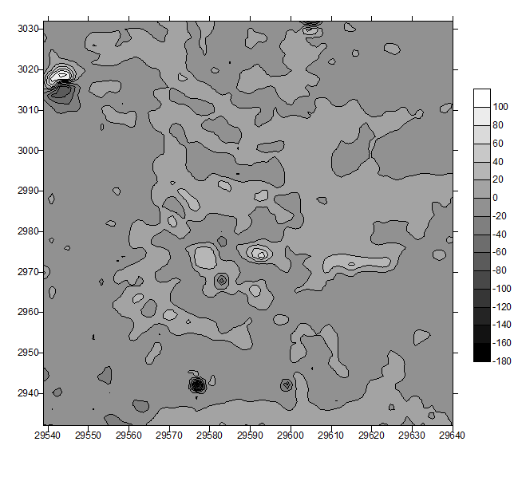
Survey and Geophysics
A. Initial magnetometry survey

Slide 28
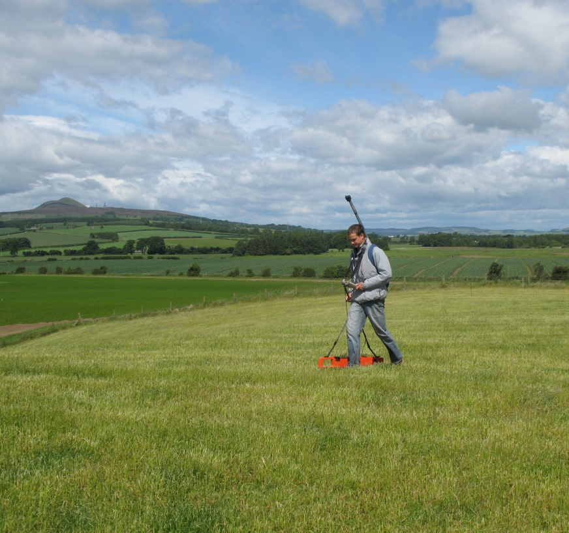
Survey and Geophysics
A. Initial magnetometry survey
B. GEM Proton Magnetometer

Slide 29
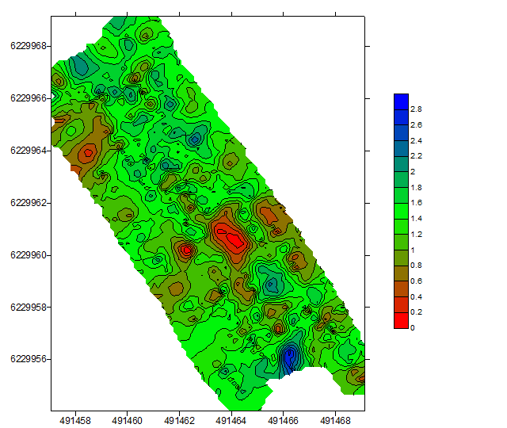
Survey and Geophysics
A. Detailed magnetometry survey
B. GEM Proton Magnetometer

Slide 30
Survey and Geophysics
A. Detailed magnetometry survey
B. GEM Proton Magnetometer

Slide 31
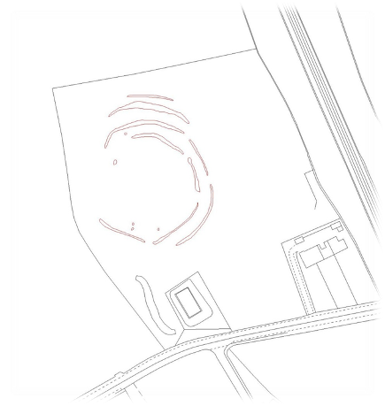
Community excavation
A. Excavation Strategy

Slide 32
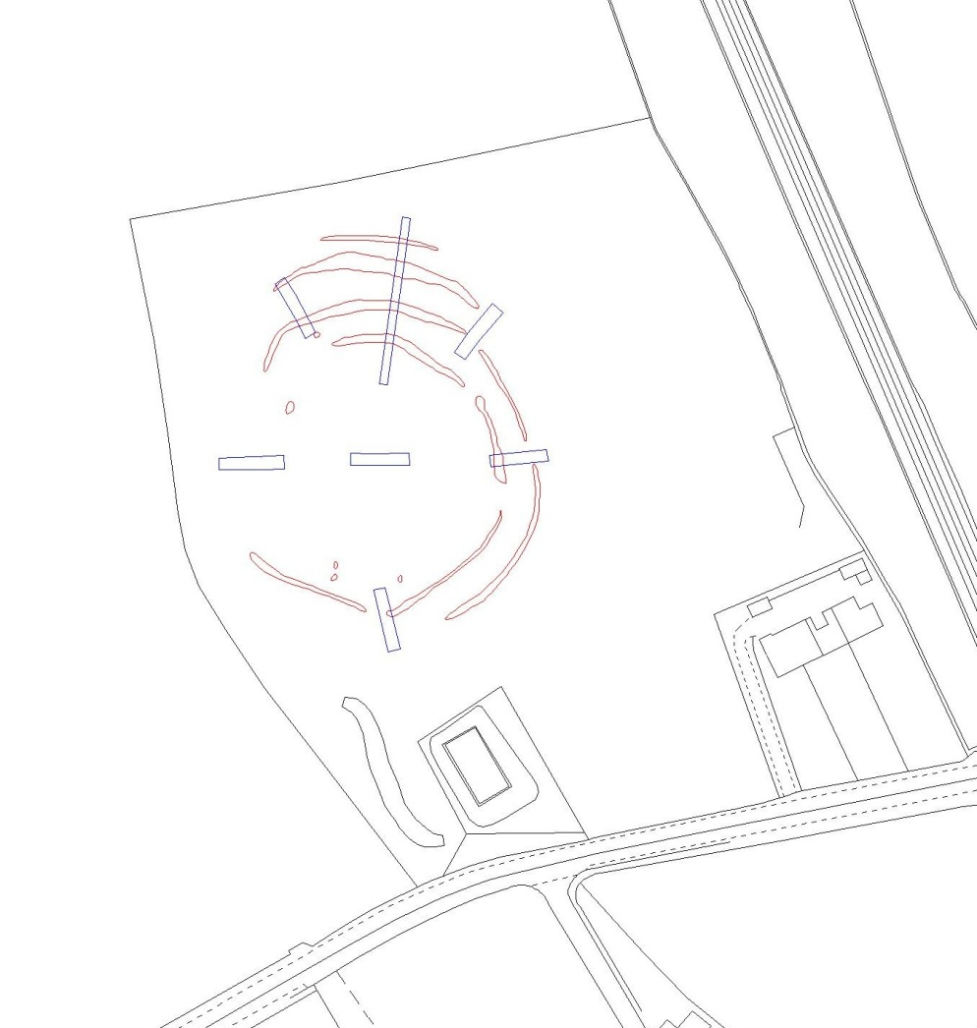
Community excavation
A. Excavation Strategy

Slide 33
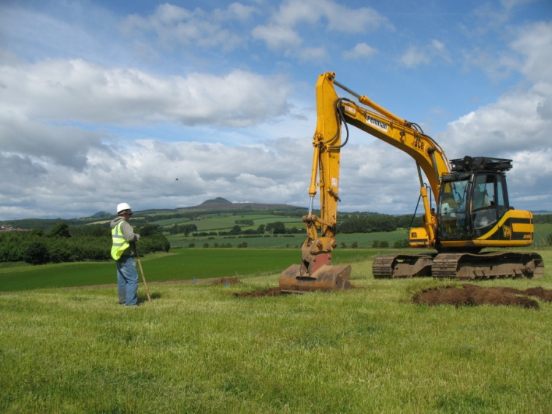
Community excavation
B
A. Excavation Strategy

Slide 34
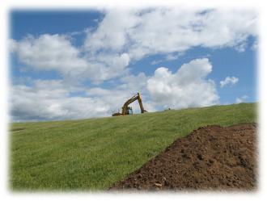
Community excavation
B
C
A. Excavation Strategy

Slide 35
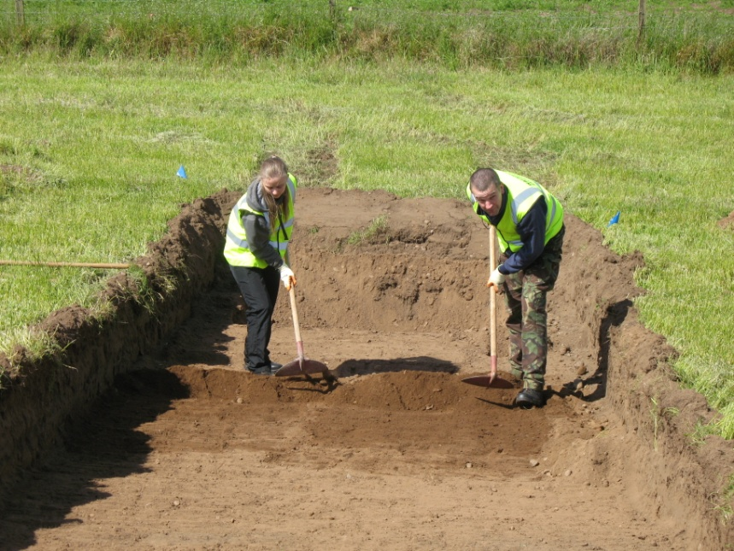
Community excavation
A

Slide 36
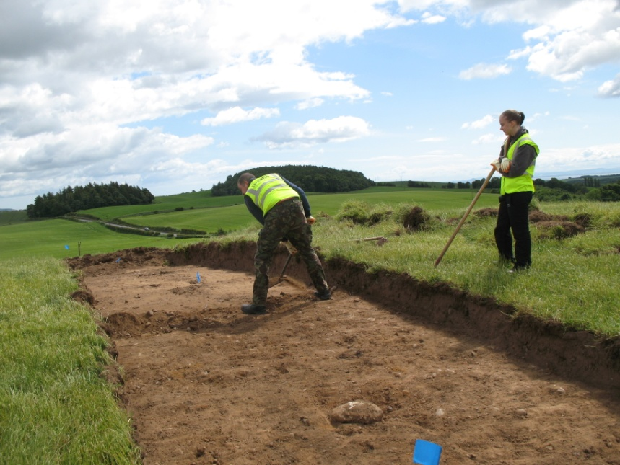
Community excavation
A
B

Slide 37
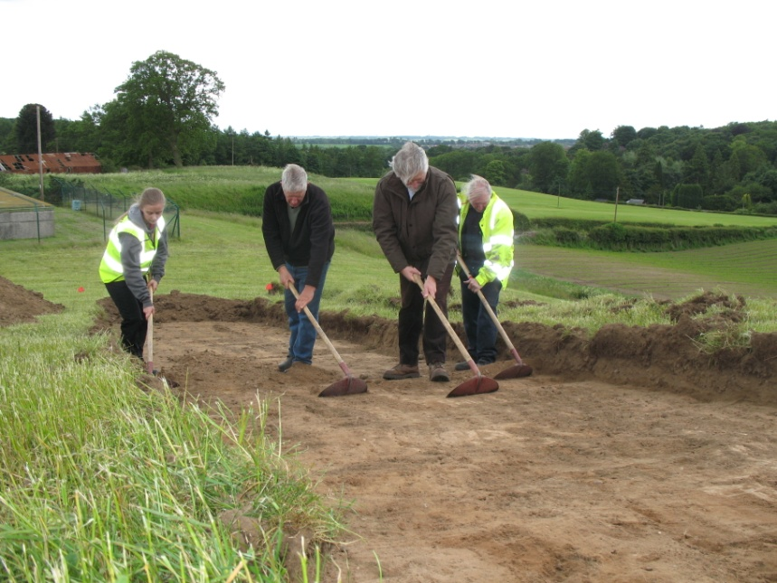
Community excavation
A
B
C

Slide 38
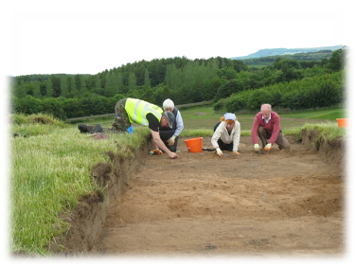
Community excavation
A
B
C
D

Slide 39
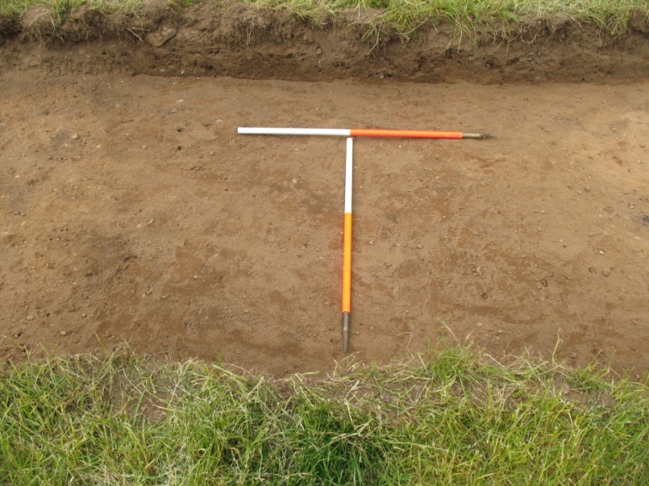
Community excavation
B
A. Excavation Strategy
Notes:
Full surface area then hand cleaned and planned to record features as exposed

Slide 40
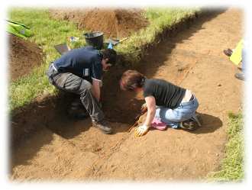
Community excavation
B
C
A. Excavation Strategy
Notes:
Full surface area then hand cleaned and planned to record features as exposed

Slide 41
Community excavation
A. Sections through ditch features

Slide 42
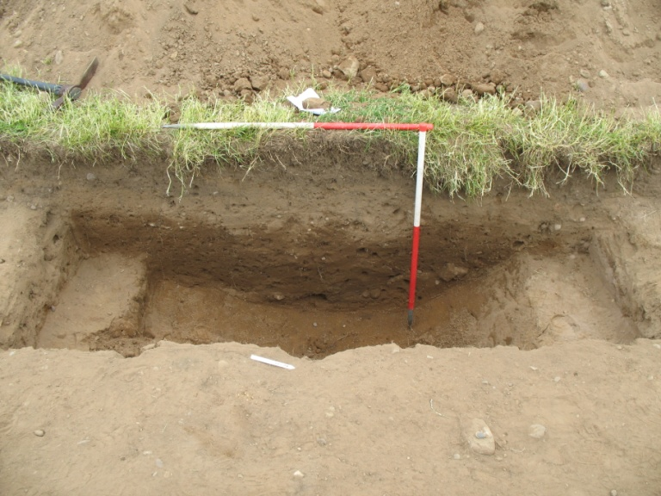
Community excavation
B
A. Sections through ditch features

Slide 43
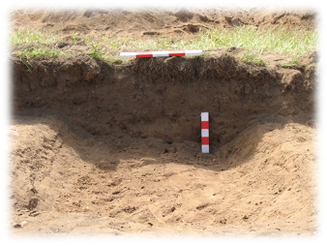
Community excavation
B
C
A. Sections through ditch features

Slide 44
Community excavation

Slide 45
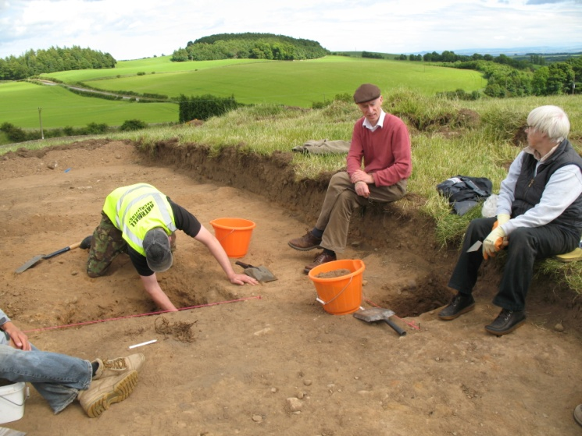
Community excavation
B

Slide 46
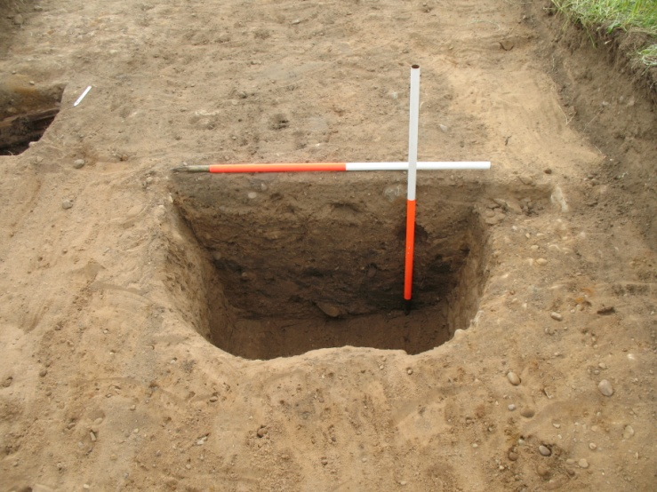
Community excavation
B
C

Slide 47
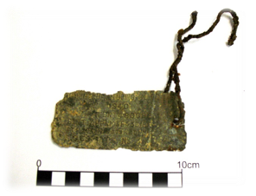
Community excavation
D
C

Slide 48
Community excavation
B

Slide 49
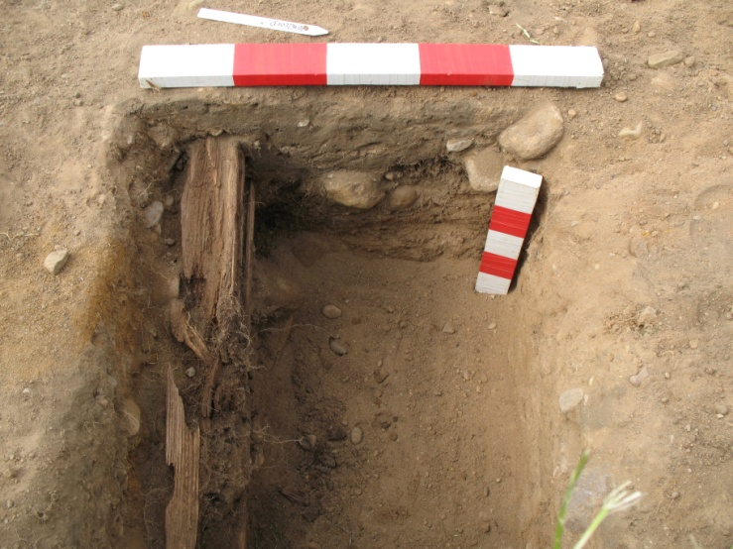
Community excavation
B
C

Slide 50
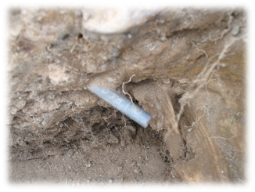
Community excavation
D
C

Slide 51
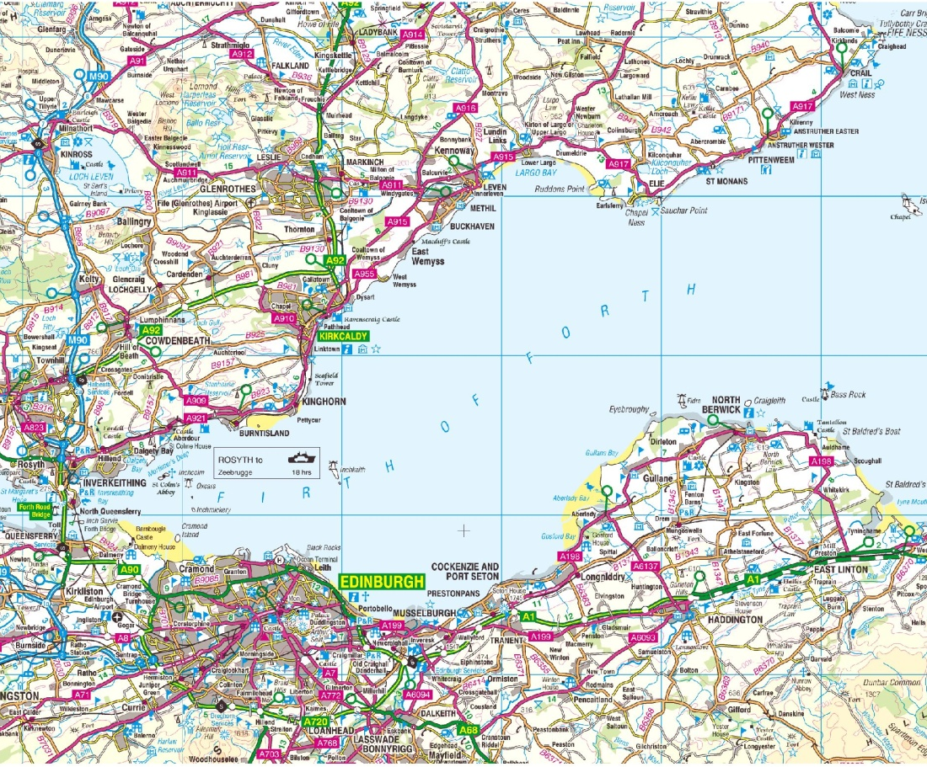
Newton in context

Slide 52
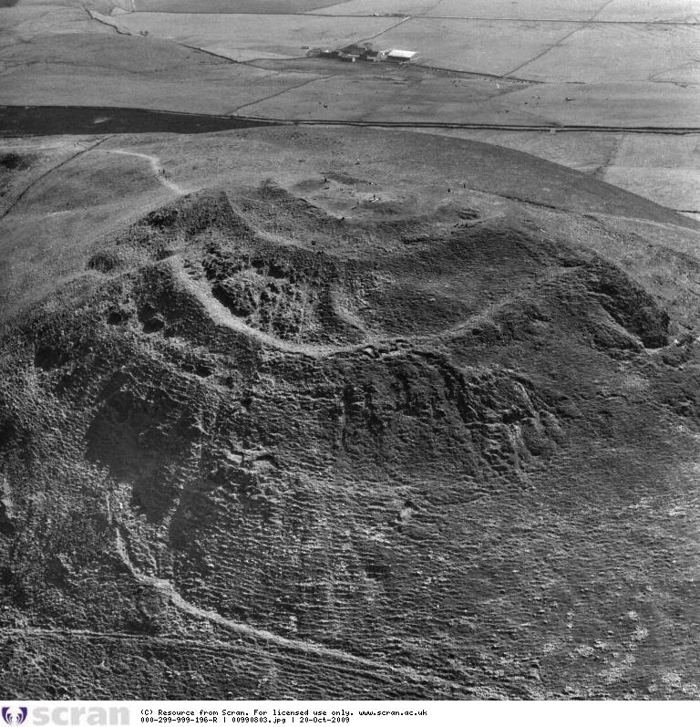
Newton in context
B

Slide 53
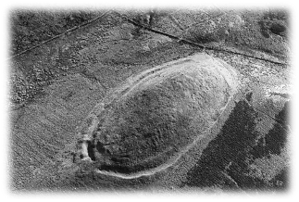
Newton in context
B
C

Slide 54
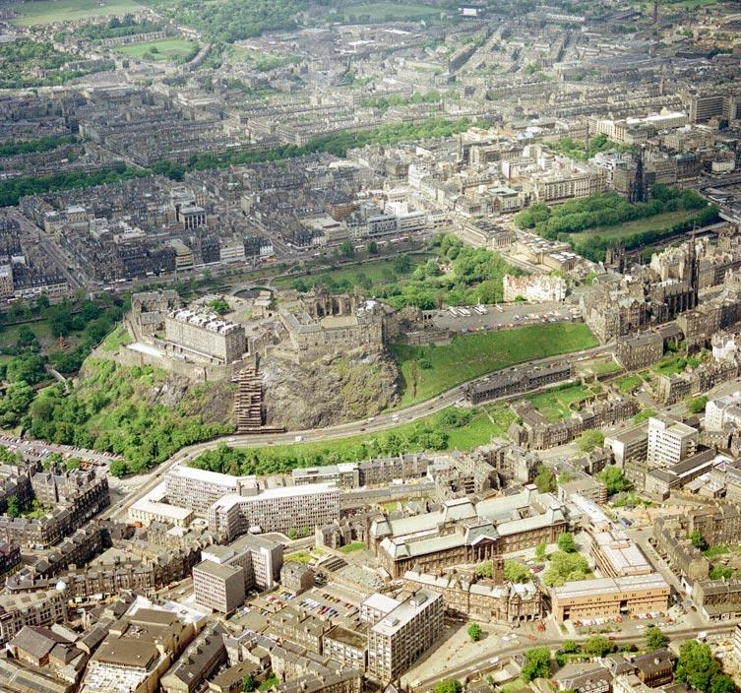
Newton in context
B

Slide 55
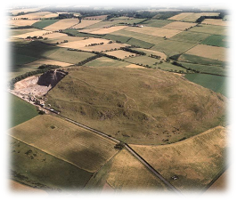
Newton in context
B
C

Slide 56
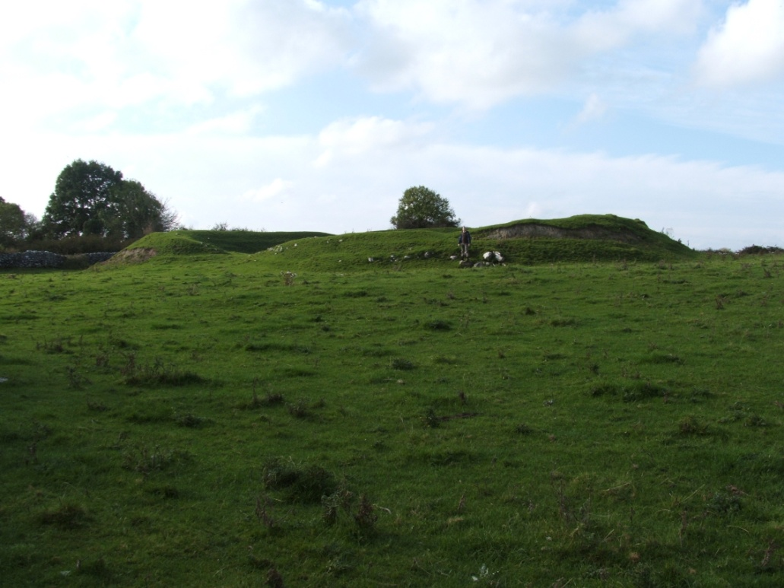
Newton in context
A

Slide 57
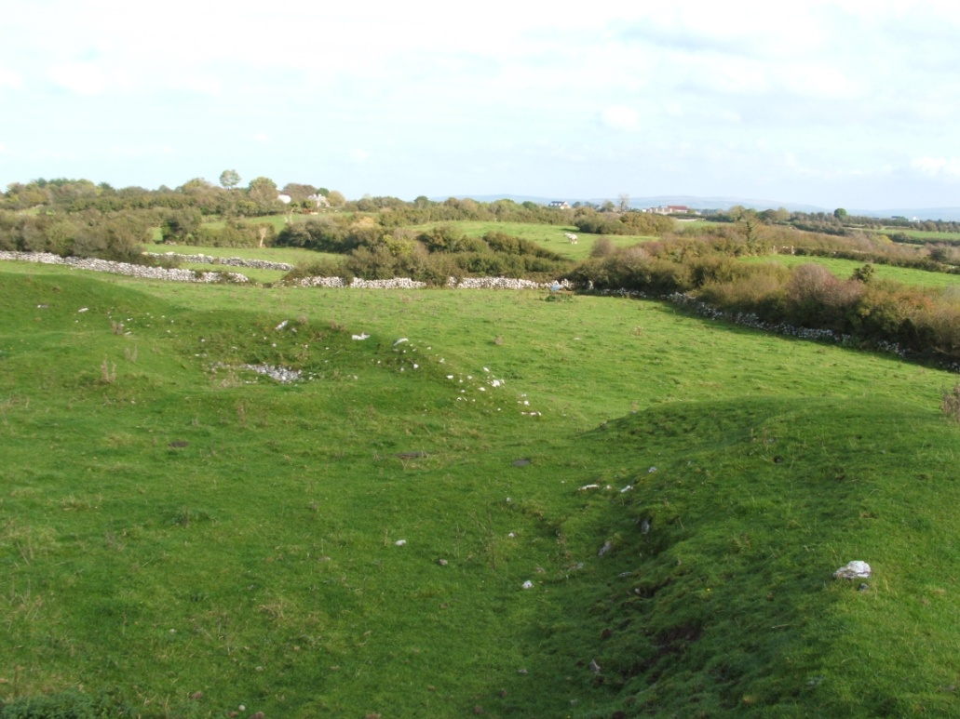
Newton in context
A
B

Slide 58
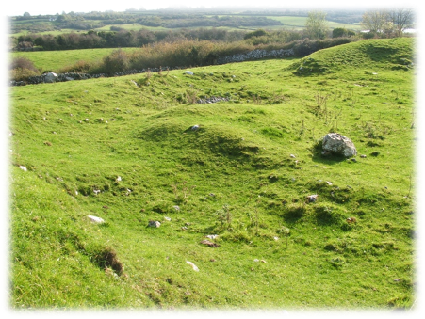
Newton in context
A
B
C

Slide 59
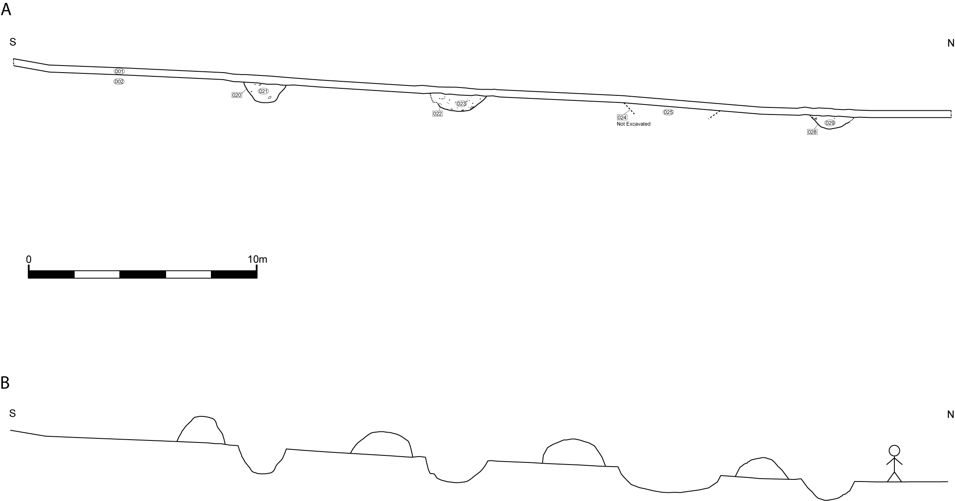
Newton in context

Slide 60
Newton in context

Slide 61
Newton in context
A. Newton Enclosure

Slide 62
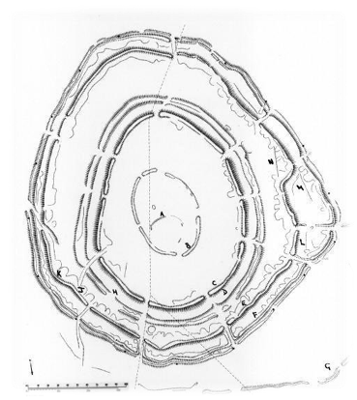
Newton in context
A. Newton Enclosure
B. Brown Caterthun

Slide 63
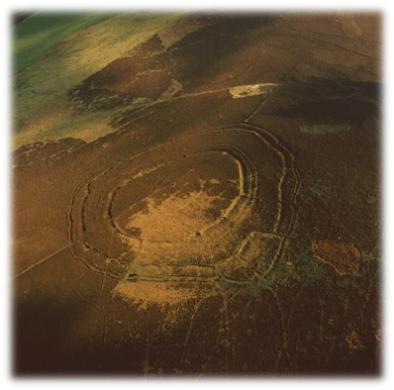
Newton in context
A. Newton Enclosure
B. Brown Caterthun

Slide 64
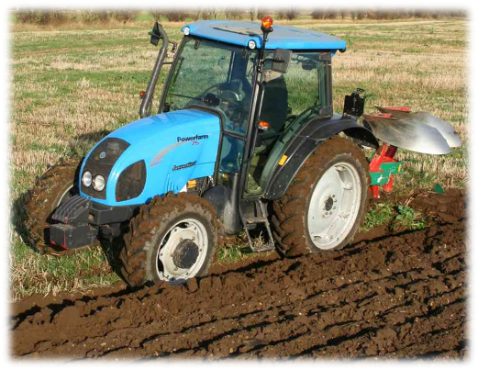
Newton in context

Slide 65
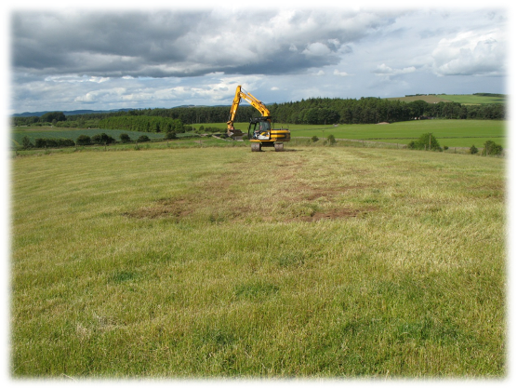
Newton in context

Slide 66
Summary
Multi-vallete ditched enclosure
Identified by oblique aerial photography
Within the tradition of Iron Age enclosures
No material culture within ditch fills
No substantive contemporary settlement
A part completed enclosure?
A heavily damaged site?
A symbolic enclosure?

Slide 67
Acknowledgements
RCAHMS staff
Douglas Speirs – Council Archaeologist
Markinch Heritage Group
Douglas Gordon & Rathmell Archaeology staff

